Slide 1

Predictive Analysis On Repair Industry Around The Globe

Slide 2
Group Members
MUHAMMAD UZAIR MSDS20053
ABDULLAH AZIZ MSDS20052
KHUZAIMA SHAHID MSDS20039
MUHAMMAD MUBASHIR ALI MSDS20085
QAZI DANISH AYUB MSDS20075
HIRA SALEEM MSDS20104
RAMEESHA MAHMOOD MSDS20089
MUHAMMAD ARSLAN AFZAL MSDS20035
AHMAD NAWAZ MSDS20093

Slide 3
Problem Statement
Predictive Customer Churn Using Classical Machine Learning……..?

Slide 4
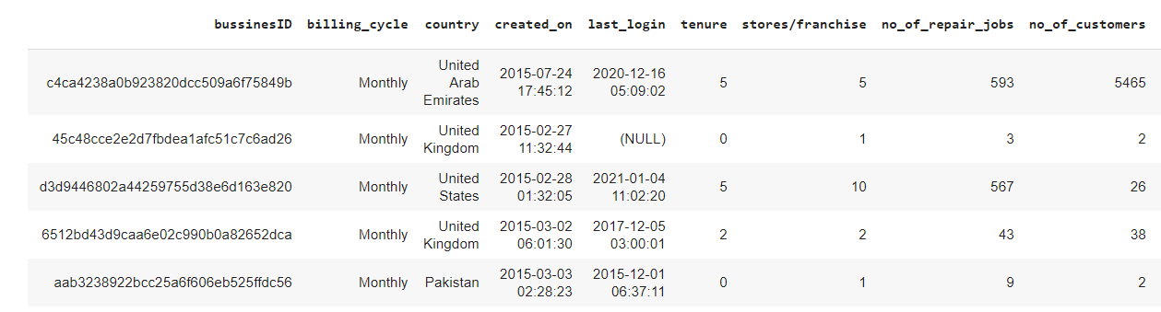
Dataset

Slide 5
Flow Diagram
Data Gather & Understanding Data
Preprocessing / EDA
Data Cleaning
Data Transformation/Attribute Selection/Normalization
Classification Model
Result & Comparisons

Slide 6

Data Gathering & Pre-processing
Data Gathering
Important Columns
Tenure
Credit Amount
Average Sales
Attributes Types
Binary
Bool
Categorical
Data Pre-processing
Dropped columns
Bussines_Id
Created on
Last login
country
Other Techniques
Encoding And Scalar Technique
Group By Different Attribute Against Target Attribute
Average Sales column

Slide 7
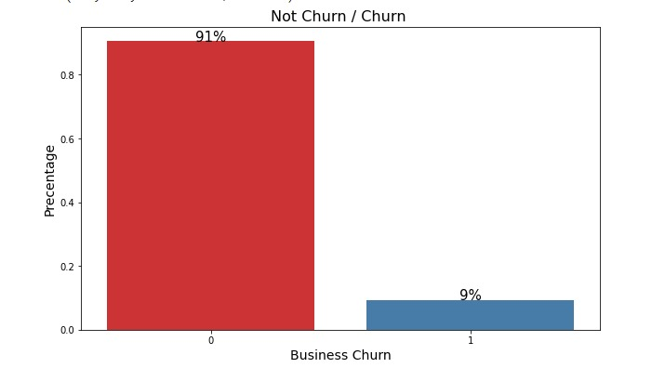
Data Gathering & Pre-processing
Class Imbalance Problem
Notes:
Billing cycle ( monthly, yearly to 0,1) these columns will give 90% precesion we wouldn't be able to train model
Country US had most customer retention thats why it will always be assigned to zero class

Slide 8
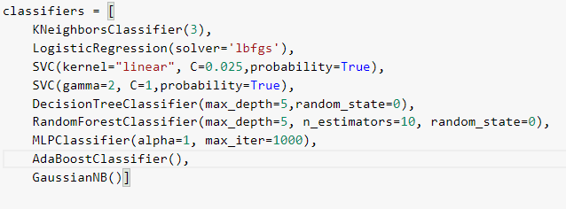
Algorithms Applied
K Nearest Neighbours
Logistic Regression
Linear SVM
RBF SVM
Decision Tree
Random Forest (Best Results)
Neural Net
AdaBoost
Naive Bayes

Slide 9
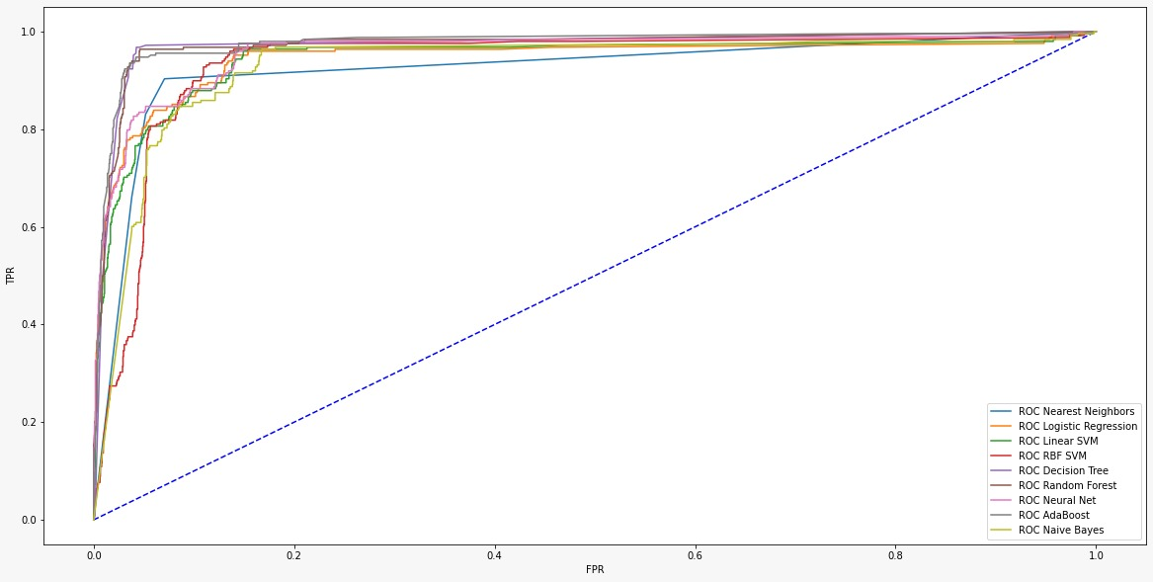
Roc curves (Result)

Slide 10
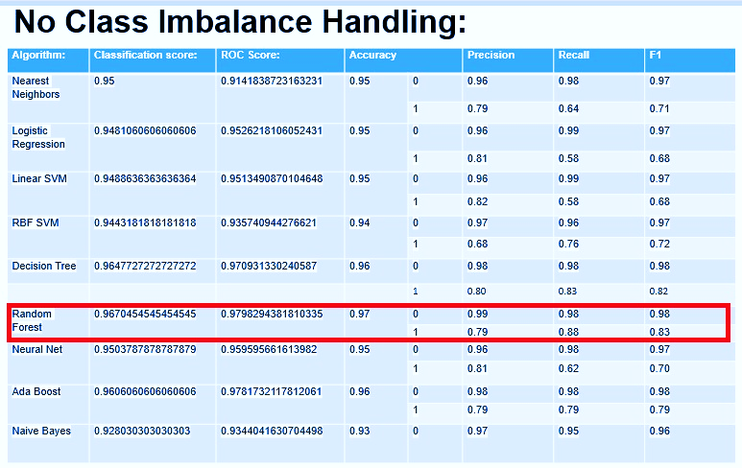
Precision & Recall

Slide 11
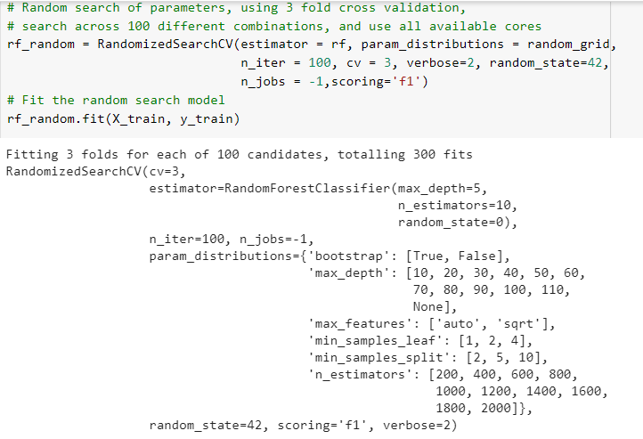
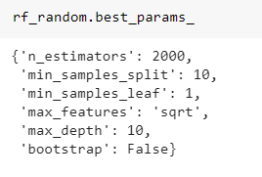
Random search cv

Slide 12
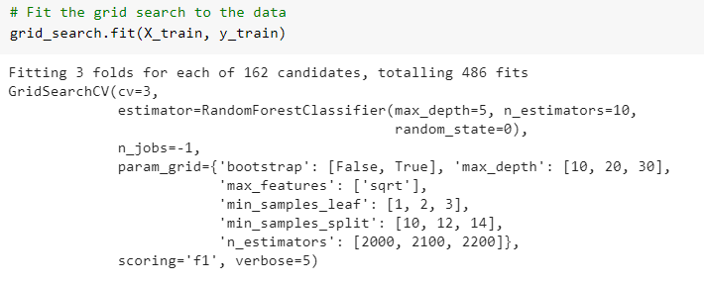
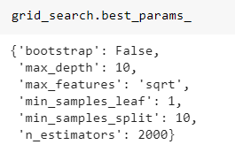
GRIDsearch cv
GridSearchCV

Slide 13
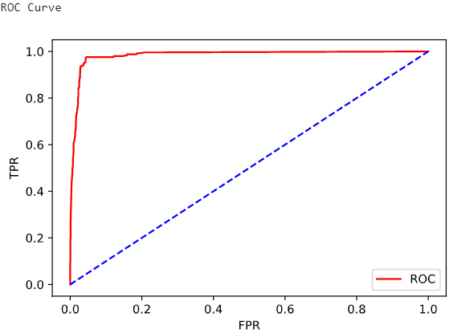
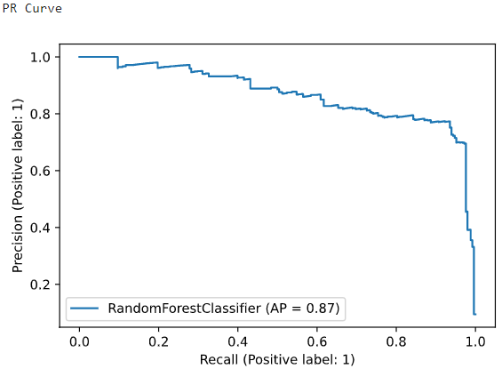
Random Forest
Maximum precision ,recall
And F1 score
Good ROC Curve

Slide 14
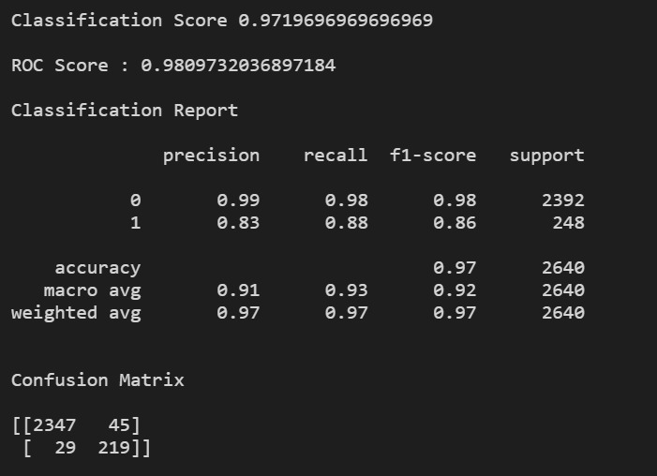
BEST model for rfc

Slide 15
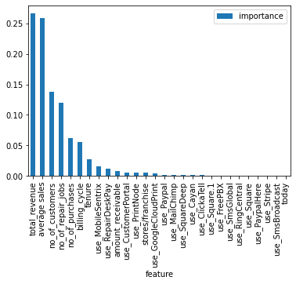
Feature Importance

Slide 16
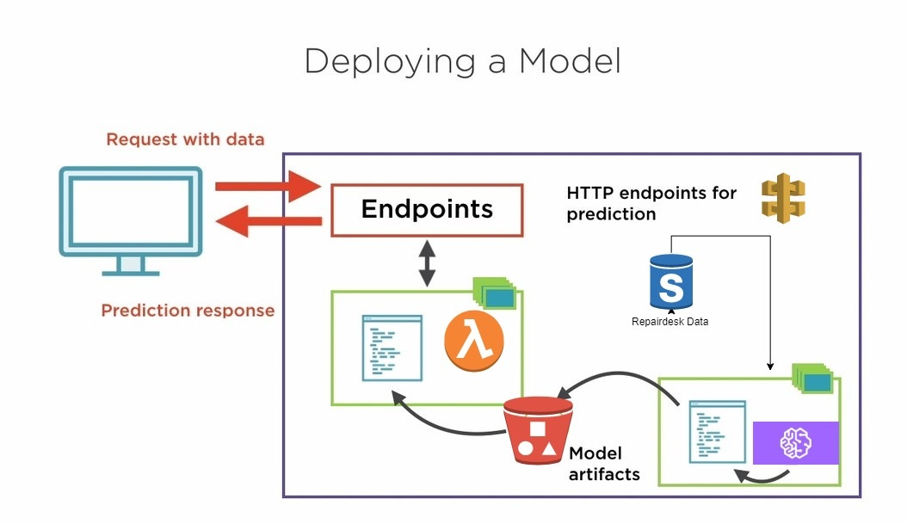
Model Deployment

Slide 17
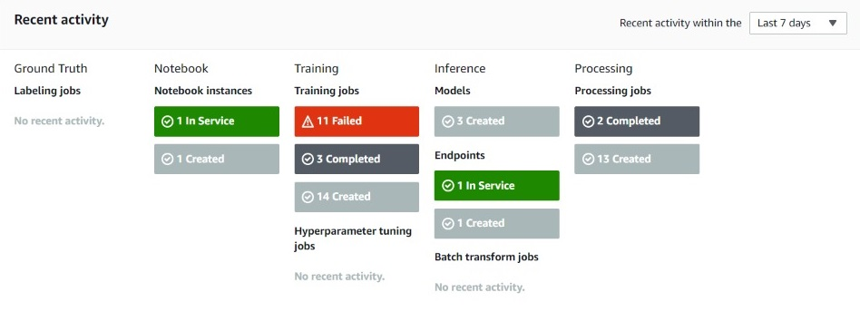
Model Training Activity

Slide 18
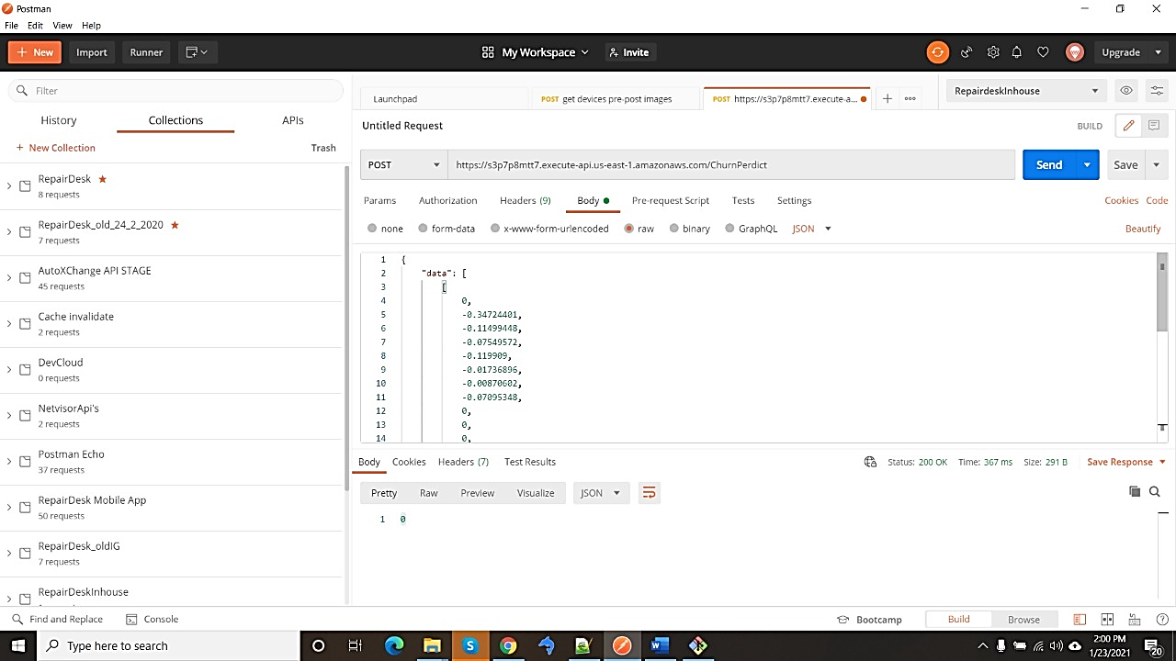
Http Request To Predict

Slide 19
Business Impact
Customer retention is crucial to the long-term success of your business
Ability to calculate and utilize churn prediction effectively
Before time we can alarm company that this customer will leave
Preventing lost revenue

Slide 20
Class Balancing Techniques
Class weight
Under Sample
Balanced Resampling
SMOTE

Slide 21
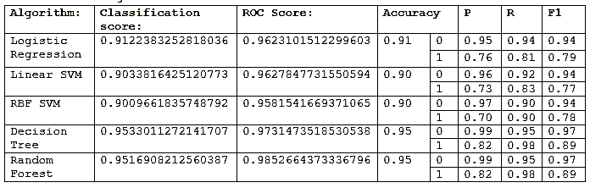
Class Weight Balanced

Slide 22
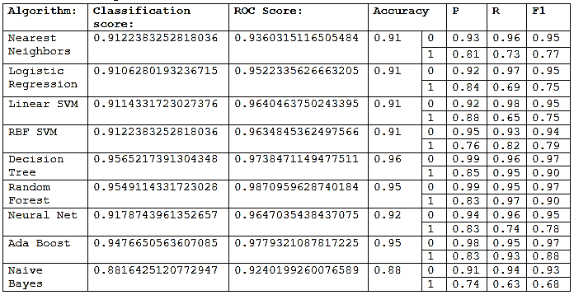
Under Sample

Slide 23
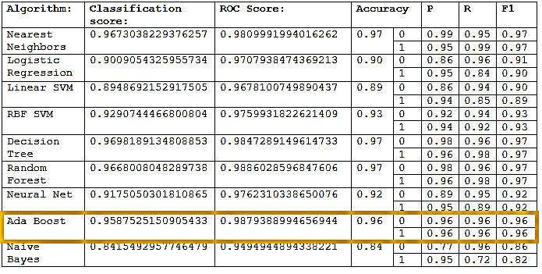
Balanced Resampling (Class 0 down sample, Class 1 up sample)

Slide 24
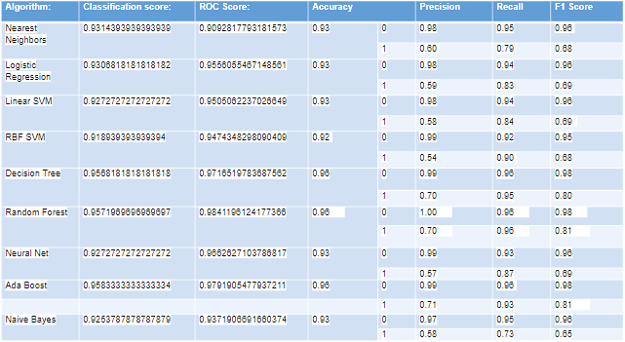
SMOTE

Slide 25


